Slide 1

Agile 101

Slide 2
Agenda
01
Waterfall Basics
02
Agile Overview
AGILE INTRO LEARNING OBJECTIVES
Pre-agile waterfall methodology basics
Agile Manifesto & Values
Agile Principles
What agile is and is not
Benefits of employing agile practices
Next steps to continue exploring the agile way
Common Misconceptions
Characteristics of Agile Practices
03
Three Agile Components
04
Agile Journey

Slide 3
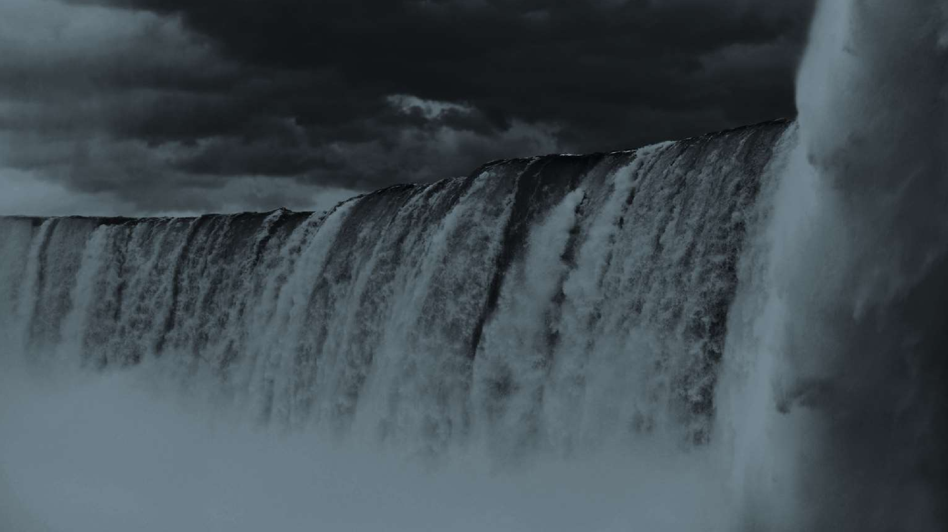
Waterfall
A traditional approach to project management.

Slide 4
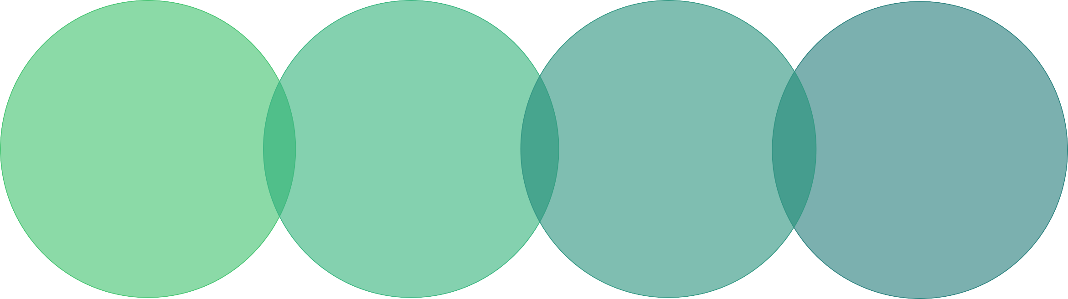




Project Management 101
Project Management
Project Manager
Project
Project Team
Planned program of work that requires a definitive amount of time, effort and planning to complete.
Processes used to complete a project.
Individual who plans and directs the work required to complete a project.
Individuals that do the work to deliver on project deliverables.

Slide 5
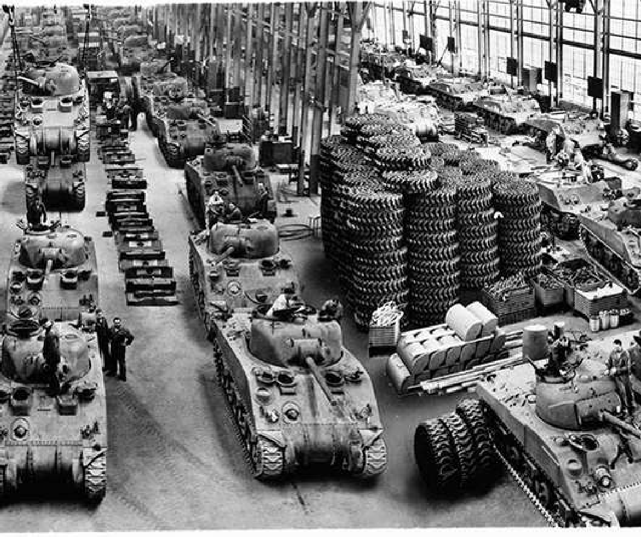
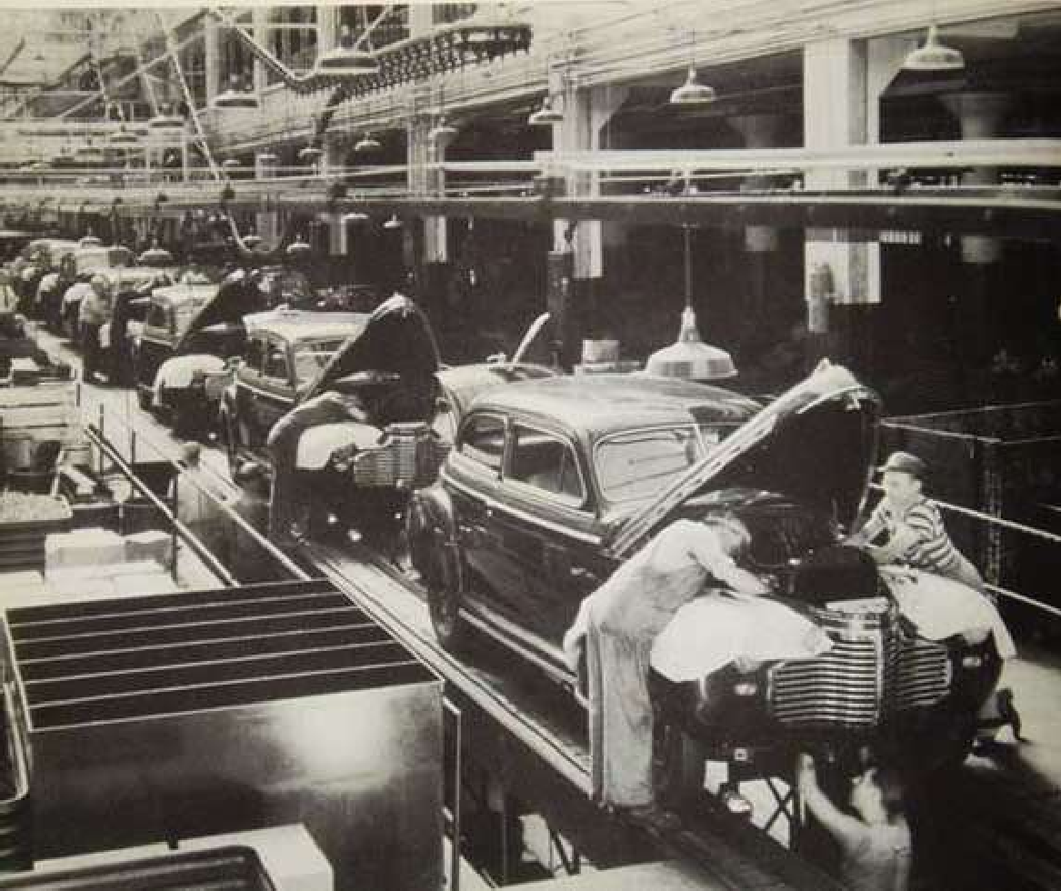
History of Waterfall Project Management
Photo Courtesy of thwapschoolyard.com
Photo Courtesy of flintgm100.com
Project management processes were developed based on step-by-step manufacturing models the United States military used during World War II.
Waterfall process developed from highly structured physical environments where after- the-fact changes are prohibitively costly, if not impossible.

Slide 6
In the waterfall method to managing projects, you complete work in stages. You do not move to another stage until you have completed the work in the previous stage.
Requirements
Design
Development
STAGES DEFINED
Testing
Deployment

Slide 7
14%
Waterfall Project Stats
57%
29%
Successful Challenged Failed
The Standish Group defines project success as on time, on budget, and with all planned features. They do not report
how many projects are in their database but say that the results are from projects conducted from 2002 through 2010.
- Mike Cohn, Mountain Goat Software on the CHAOS Manifesto 2012 Report

Slide 8
Impaired Project Issues
Standish Group, 2012 Chaos Report
20%
15%
10%
5%
13%
12%
10%
9%
9%
8%
8%
7%
0%
Incomplete
Requirements
Lack of User Involvement
Lack of
Resources
Unrealistic
Expectations
Lack of Executive Support
Challenging Requirements & Specs
Lack of
Planning
Didn’t Need
It Any Longer

Slide 9
Start to Finish Issues with Waterfall
Customers or stakeholders may not be available for questions
Finish
Final testing
Must wait for full and complete user feedback
Value not achieved
until end
Must resist change or document change requests (which extends schedule and budget)
Start
Must have all requirements up front
Estimation is complex
Must understand capabilities of all involved
Team must create and maintain volumes of documentation

Slide 10
Insanity: doing the same thing over and over and expecting different results.
- Albert Einstein

Slide 11
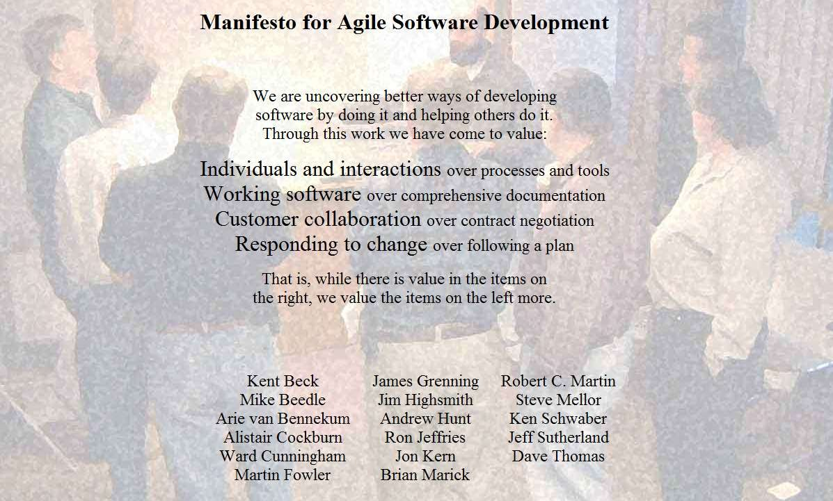

Agile Manifesto

Slide 12
Agile Manifesto: Statement of Values
Individuals and Interactions
OVER PROCESS AND TOOLS
Working Software
OVER COMPREHENSIVE DOCUMENTATION
Customer Collaboration
OVER CONTRACT NEGOTIATION
Responding to Change
OVER FOLLOWING A PLAN

Slide 13
12 Guiding Agile Principles
Customer Satisfactio n |  | Quality | Team- work | Project Mgmt
Customer satisfaction by rapid delivery of useful software | P | P
Welcome changing requirements, even late in development | P |  |  | P
Working software is delivered frequently (weeks rather than months) | P | P
Working software is the primary measure of progress |  | P
Sustainable development, able to maintain a constant pace |  | P | P | P
Close, daily co-operation between business people and developers | P | P | P
Face-to-face conversation is the best form of communication |  | P | P
Projects are built around motivated individuals, who should be trusted |  |  | P
Continuous attention to technical excellence and good design |  | P
Simplicity – the art of maximizing the amount of work not done |  |  |  | P
Self-organizing teams |  |  | P
Team regularly reflects on how to become more effective, then adjusts |  | P | P

Slide 14
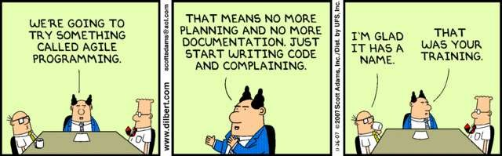

Slide 15


Textbook Definition
Agile = entity that possesses agility
Agility or nimbleness is the ability to change the body’s position efficiently. Requires the integration of isolation skills using...
Balance
Coordination
Speed
Reflexes
Strength
Endurance

Slide 16

What is Agile, Really?
Agile is a mindset.

Slide 17























Common Misconceptions
No more
planning
No more QA
Change req’s whenever
Agile = Scrum
Agile isn’t disciplined
No more docu- mentation
Agile doesn’t scale
Allows you to go faster
No more design

Slide 18

Agile
scrum
Crystal
Kanban
FDD
X P
RUP
CI
and a few more…

Slide 19

Prescriptive vs. Adaptive
The Sweet Spot
X P
13
Do whatever!
0
RUP
120
Kanban
3
scrum
9
More Prescriptive
more rules to follow
More Adaptive
fewer rules to follow

Slide 20

Agile vs. Lean
LEAN
Deciding as
Building integrity in
Delivering as fast as possible
Amplify learning
Eliminate waste
Empowering the team
See the whole
late as
possible
AGILE
Multi-level planning (release/epic
/story)
Emergent feature discovery
Deliver working software
Self- organized teams
Fixed- length iterations
Fail early, fail often
Value driven development

Slide 21
Sequential vs. Overlapping Work
Requirements
Design
Code
Test
4 weeks
4 weeks
4 weeks
4 weeks
Time

Slide 22
Iterative Work
2 Years – No Change
Potential Change
Potential Change
Potential Change
Potential
Change
Potential Change
Potential
Change
Potential Change
2 Week Increments

Slide 23
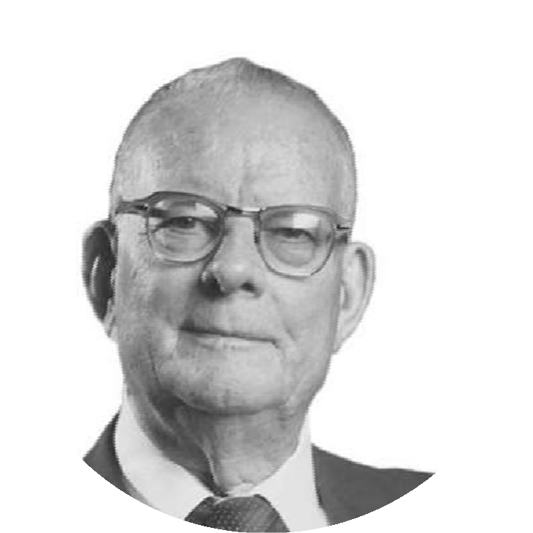
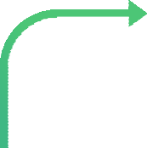
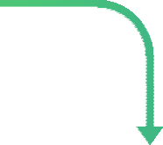


PDCA
PLAN
ACT
DO
William Edwards
“Cease dependence on inspection to achieve quality. Improve the process and build quality into the product in the first place”
CHECK

Slide 24

Team regularly reflects on how to become more effective, then adjusts.

Slide 25
Agile Components

Slide 26

Agile Component: Framework
Definition of Framework
Adaptive software development (ASD)
Agile modeling
Agile Unified Process (AUP)
Business analyst designer method (BADM)
Crystal Clear Methods
Disciplined agile delivery
Dynamic systems development method (DSDM)
Extreme programming (XP)
Feature-driven development (FDD)
Lean software development
Kanban (development)
Scrum
Scrumban
Spiral
Iterative
A framework is a real or conceptual structure intended to serve as a support or guide for the building of something that expands the structure into something useful.

Slide 27
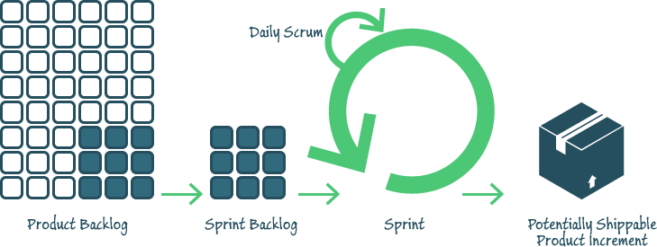
Framework Example: Scrum Framework

Slide 28

Agile Component: Practice
Definition of Practice
XP
User Story
CI/CD
User Story Mapping
FDD
ATDD
TDD
Agile Modeling
Emergent Design
RUP
Agile modeling
Backlogs (Product and Sprint)
Behavior-driven development (BDD)
Cross-functional team
Continuous integration (CI)
Domain-driven design (DDD)
Information radiators (scrum board, task board, visual management board, burndown chart)
Iterative and incremental development (IID)
Pair programming
Planning poker
Refactoring
Scrum events (sprint planning, daily scrum, sprint review
and retrospective)
Test-driven development (TDD)
Agile testing
Timeboxing
Use case
User story
Story-driven modeling
Retrospective
Velocity tracking
User Story Mapping
A practice is a repeated exercise in or performance of an activity or skill so as to acquire or maintain proficiency in it.

Slide 29


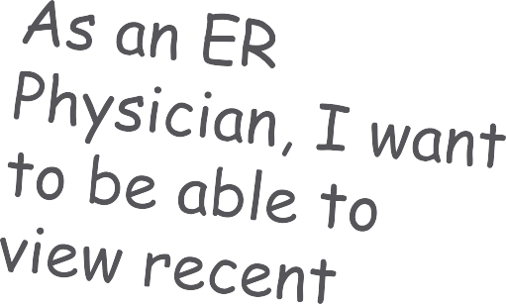
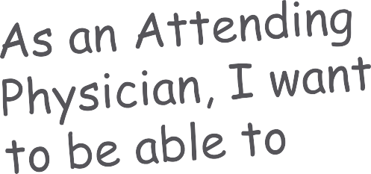
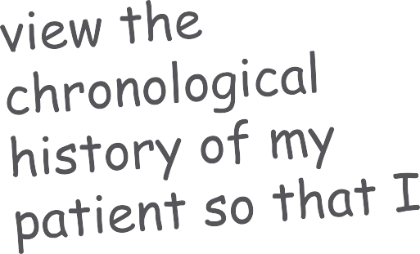
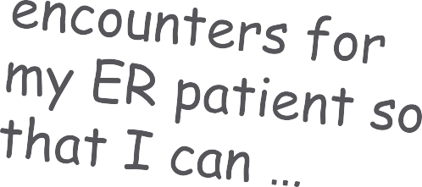
Practice Example: User Stories
32

Slide 30

Agile Component: @Scale
Definition of @Scale
Scaled agile framework (SAFe)
Disciplined Agile Delivery (DAD)
Large-Scale Scrum (LeSS)
Nexus (scaled professional Scrum)
Scrum at Scale
Enterprise Scrum
Setchu (Scrum-based lightweight framework)
Scaling agile to the enterprise level, typically with five or more interconnected teams.

Slide 31
Common Agile Misconceptions Revisited
Test as works are ready
Prioritizing the change request
Disciplined approach to practices
approaches
Required Planning
(hybrid)
Change
Agile isn’t disciplined
Agile = Scrum
No more QA
Efficient
No more
Emergent Design
Bare minimum documentation
Divide and conquer
Allows sooner

Slide 32
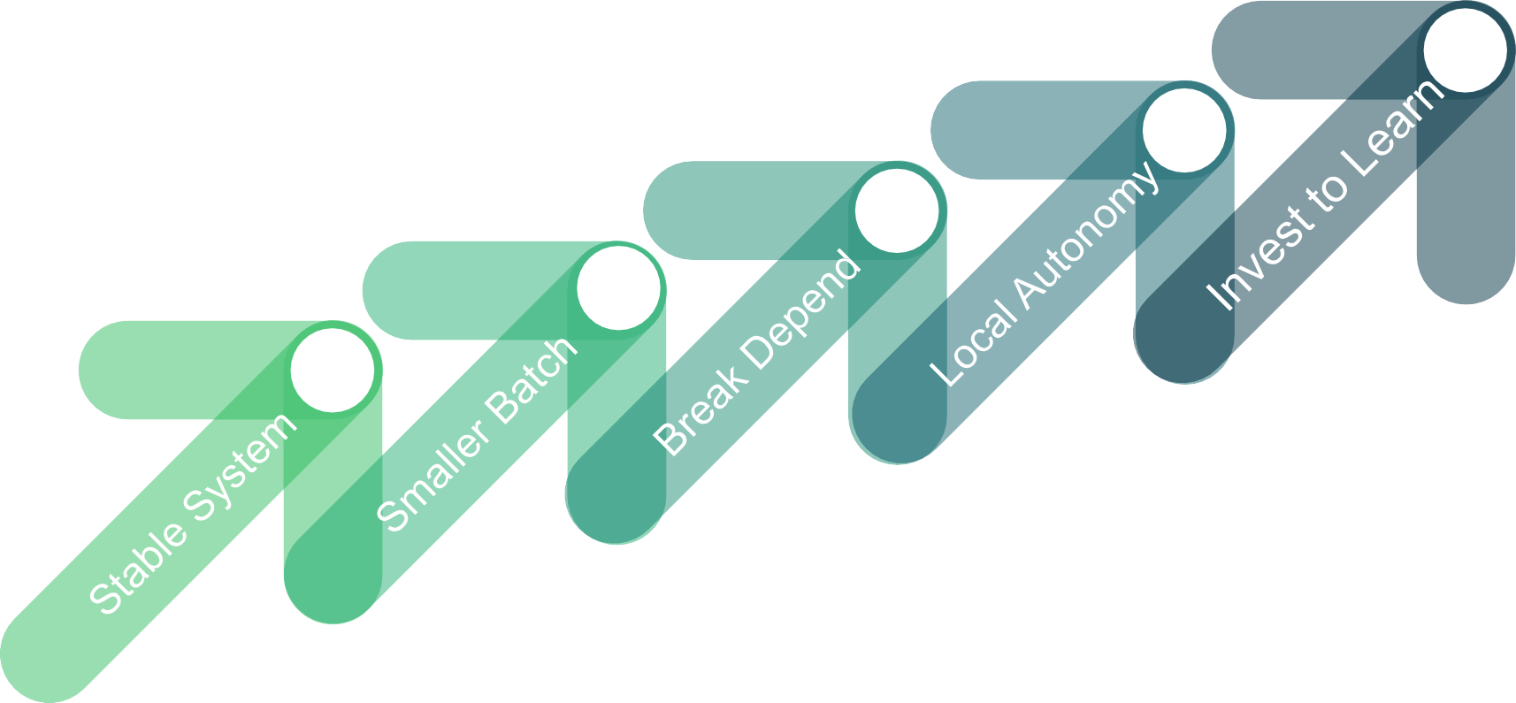
Agile Journey
Practicing what we preach
Team projects, ad.
gov., software
cap.
Lean Startup
Refactoring,
CI, and DevOps
5
Technical practices, release planning,
and metrics
4
Create backlogs, roadmaps, and agile teams
3
2
1
05 Steps
Source: http://www.leadingagile.com/the-journey/

